Slide 1

Software Presentation
Open Project
Group 2
Tatiana Uklist
Tanner Waggoner
Kevin Maldonado
Sami Eldaw
Charaf Lachouri

Slide 2
History of OpenProject
Redmine
June 2006
ChiliProject
Feb 2011
OpenProject
October 2012
OpenProject Foundation
April 2013
Notes:
OpenProject has been developed since 2010 along with its ancestor project ChiliProject.^{[10]} The initial motivation for this fork was the OPF founding members' performance, security, and accessibility requirements, which could not be easily reached by plugins for either Redmine or ChiliProject.

Slide 3
OpenProject met improved performance, security, and accessibility needs
Redmine
June 2006
ChiliProject
Feb 2011
OpenProject
October 2012
OpenProject Foundation
April 2013
Notes:
OpenProject has been developed since 2010 along with its ancestor project ChiliProject.^{[10]} The initial motivation for this, security, and accessibility requirements, which could not be easily reached by plugins for either Redmine or ChiliProject. fork was the OPF founding members' performance
Be careful when copying and pasting. Even for something such as this assignment citations or at least references to the course material would be expected. Also, listeners would appreciate an explanation of the earlier names Redmine and ChiliProject.

Slide 4
Industries that use OpenProject the most
Hospital and Health Care
Computer Software
Information Technology and Services
Oil and Energy
Internet

Slide 5
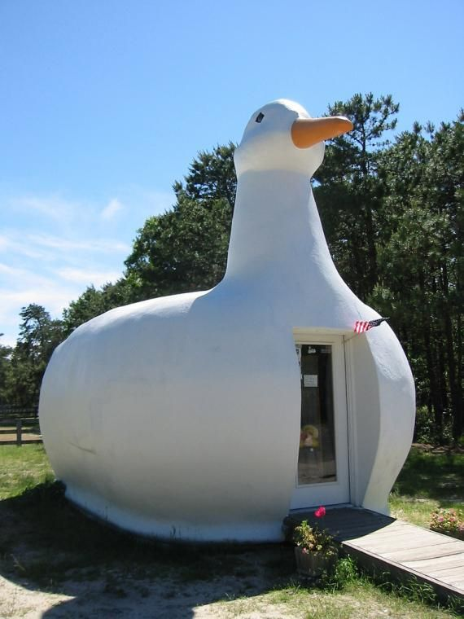
OpenProject is used across industries, especially popular in information technology and computer software industries
Hospital and Health Care
Computer Software
Information Technology and Services
Oil and Energy
Internet
Notes:
This slide implies a distribution. That is, the software is most used in IT and found less often in health care services. Does the visual support the claim, or does it mislead? Note that the shading of the sections also conveys this meaning. Note also that most readers/viewers do not prefer white (light) letters on dark backgrounds.
A better way to present the information would be to “chunk” the icons on the next slide here to demonstrate percentages. Chunking (showing many IT icons but only a few health care ones) would visually support the claim.
Also, be mindful of “ducks” in graphic design.

Slide 6



Slide 7
Notes:
This is a collection of pretty images (of mostly unfamiliar companies) evenly distributed and without a story to tell.

Slide 8
Features
Project Portfolio and Planning
Team Planner
Customizable Project Reports
Agile, Kanban and Scrum Options
Version Boards
WBS
Team Collaboration and Tracking
Live feed to updates
Track labor and unit costs
Other Features
Data encryption
Add-ons for construction industry
Native Language support

Slide 9
OpenProject has unique add-on capabilities
Project Portfolio and Planning
Team Planner
Customizable Project Reports
Agile, Kanban and Scrum Options
Version Boards
WBS
Team Collaboration and Tracking
Live feed to updates
Track labor and unit costs
Other Features
Data encryption
Add-ons for construction industry
Native Language support
Notes:
I don’t know if the claim I put in this title is true, but I do know that the original title (“Features”) is not audience focused. Listeners want stories. Listeners can remember stories because stories have structures (beginning, middle, end). Listeners also want facts, but facts only are really hard to remember.
Remember: Write for your reader, not for yourself.

Slide 10
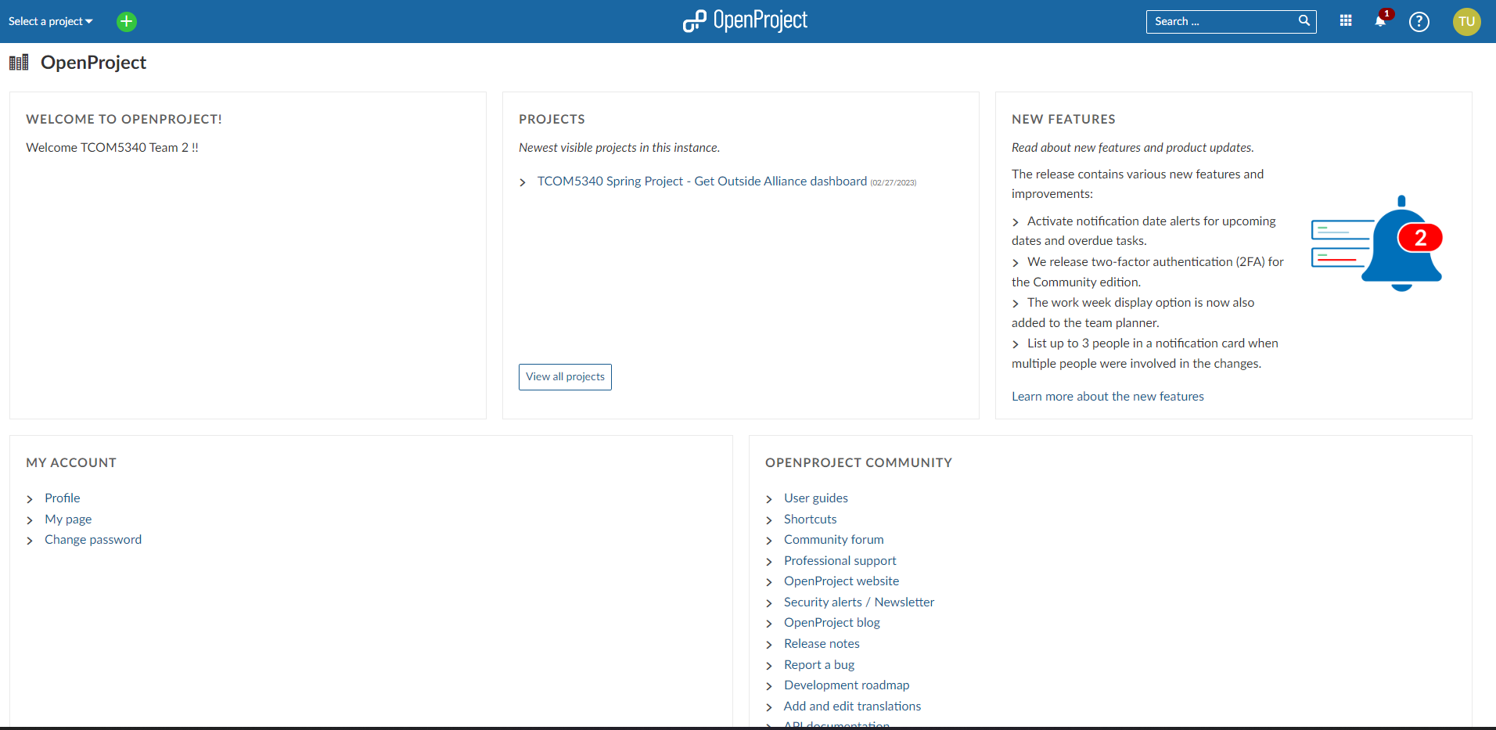
Overall Interface

Slide 11
You can change the interface to suit your needs
Notes:
The clean interface is less crowded compared to other project management systems
A less crowded interface uses less memory… (what is the benefit, what is the advantage)

Slide 12
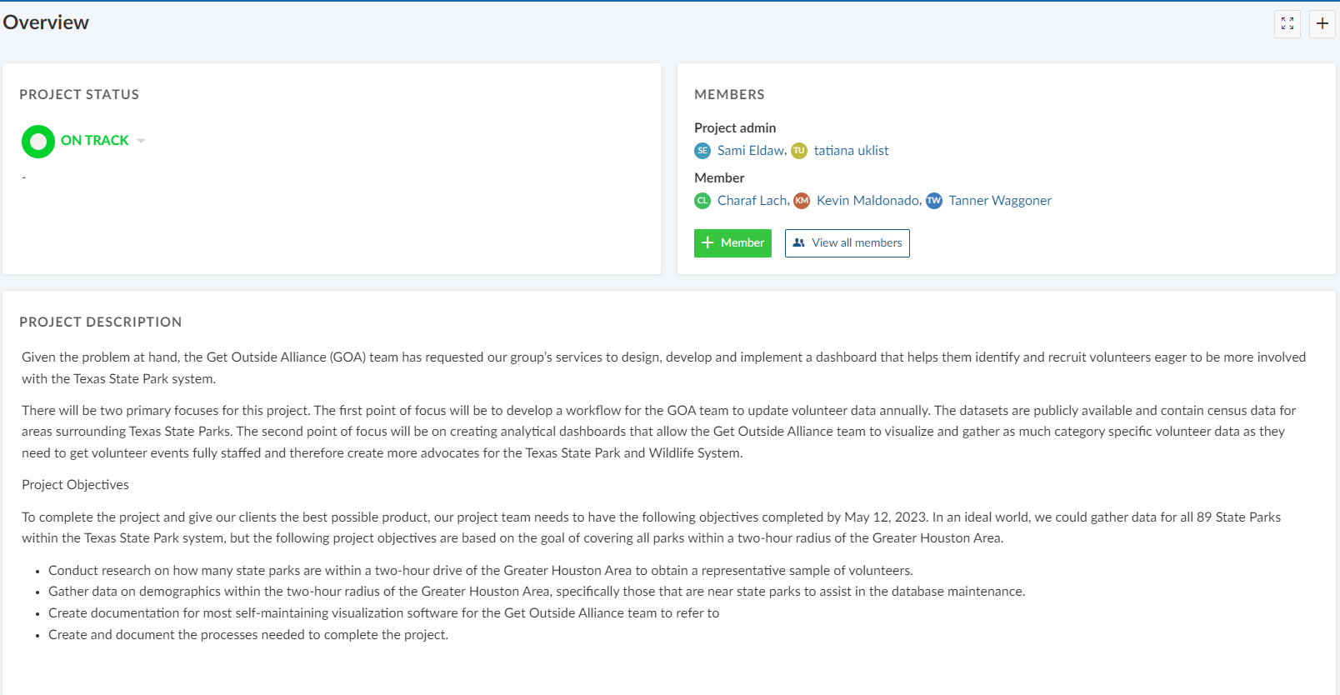
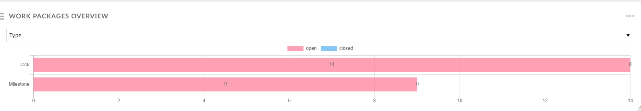
Project Interface
1
2
3
4

Slide 13
Project Interface
1
2
3
4
Notes:
Be mindful of features, benefits, and advantages.
Adjust the writing to fit the mode. Copying and pasting content from MS Word into a PM software program is likely ineffective for readers.

Slide 14
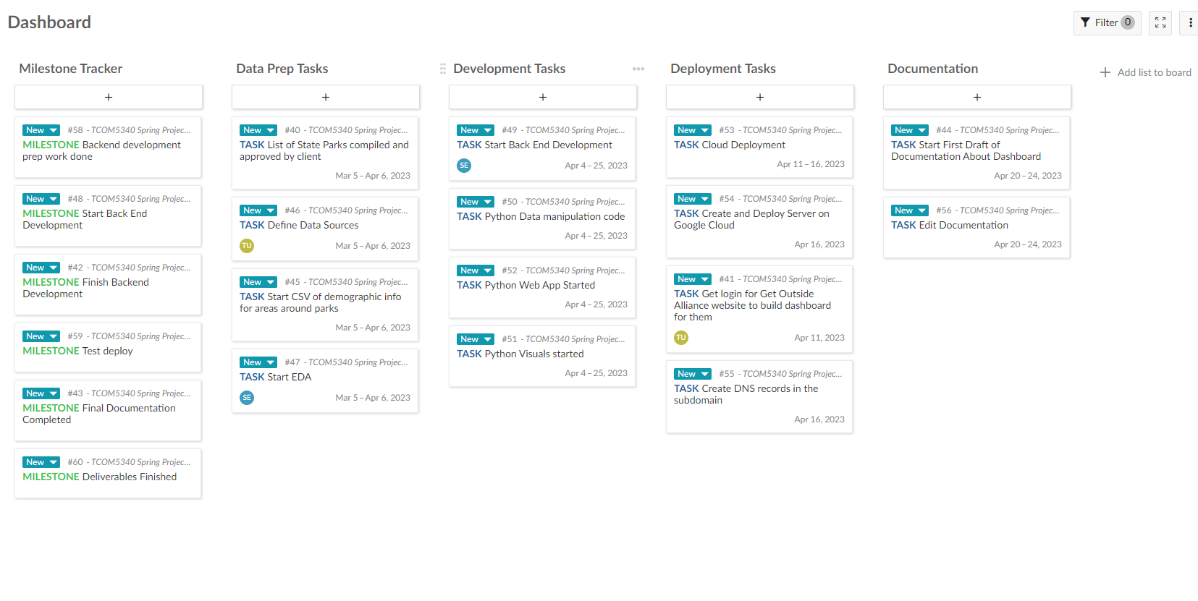
Dashboard Interface
Notes:
There is a lot of content on this slide, but it is readable for the most part. The arrangement also encourages a reading pattern. The next two slides by contrast are overloaded with content and lack structure. Most of the information is too small to process.

Slide 15
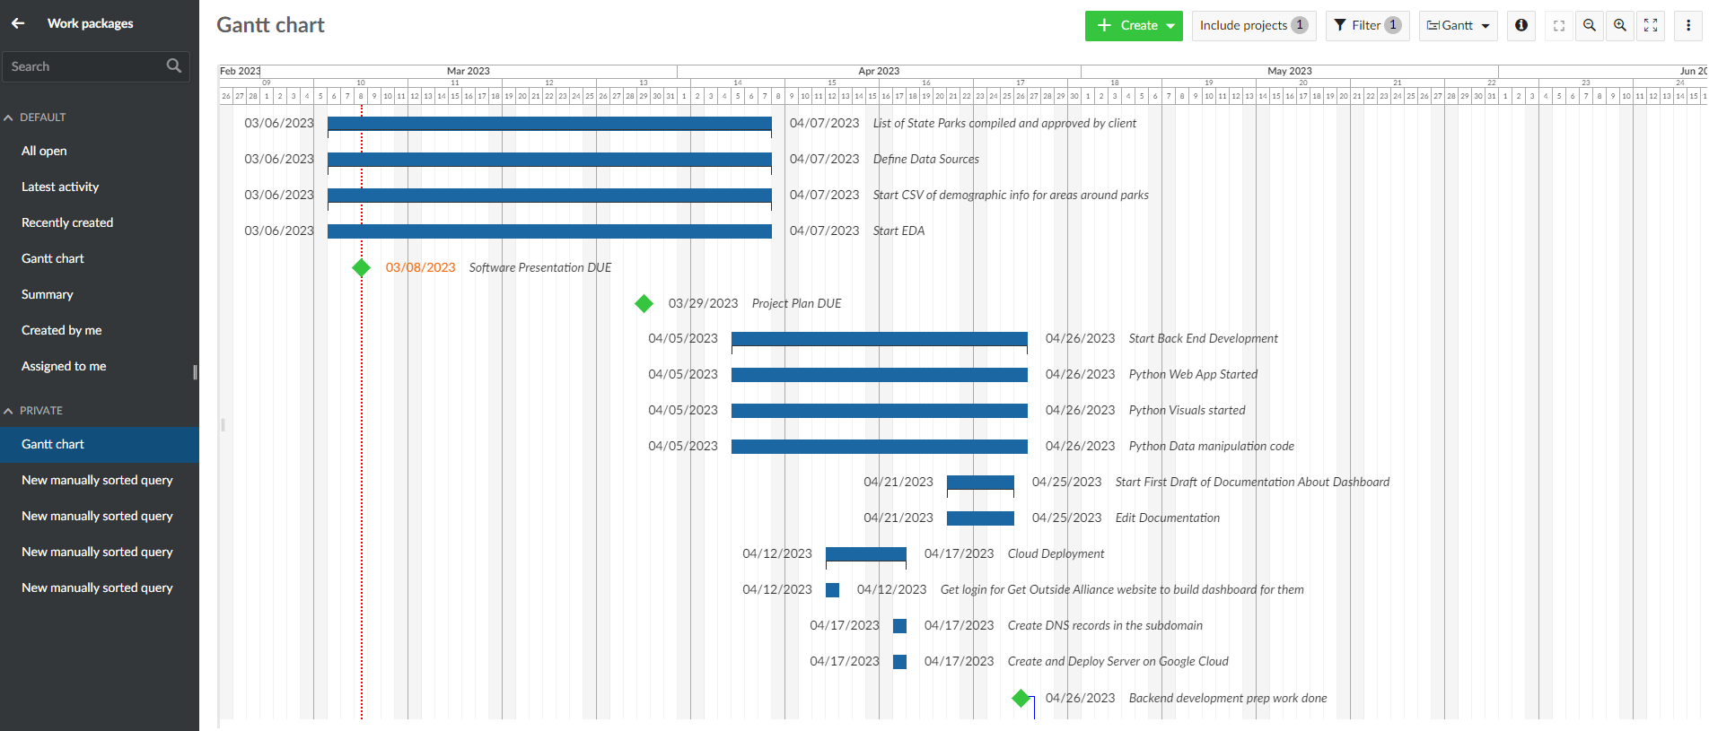
Individual Interface
Notes:
There are 14 blue bars on this slide. Each blue bar has three pieces of information. There are 44 pieces of data information on this slide alone.
The image lacks “graphical excellence.” The grid lines create visual “noise” and cause “vibrations.”
There is too much “data ink.” The ink-to-information ration (“data ink maximization”) needs to be adjusted.

Slide 16
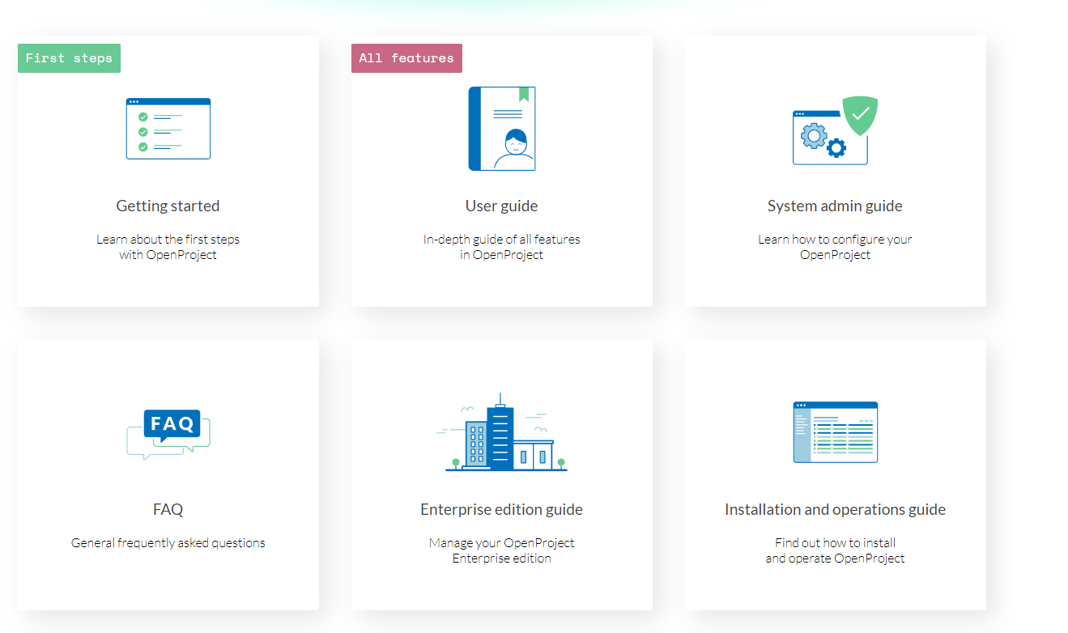
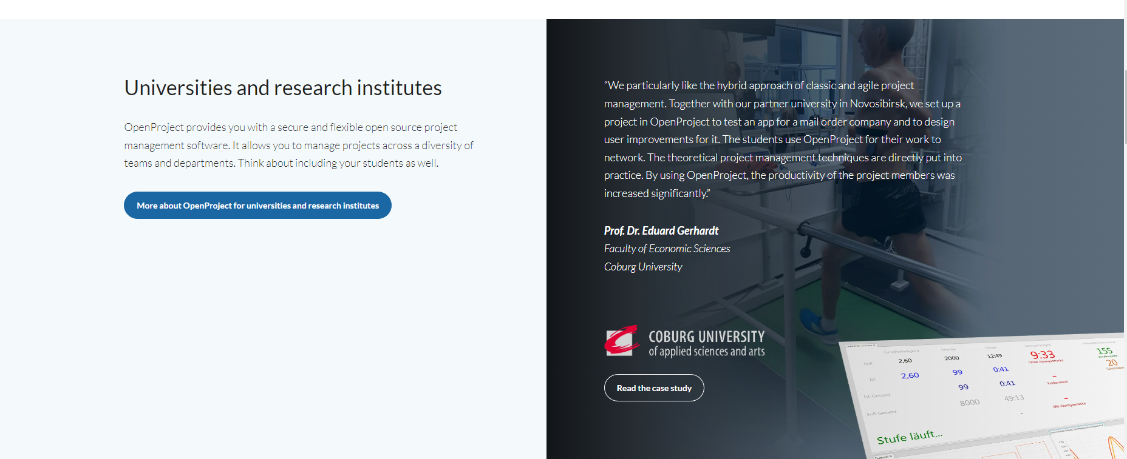
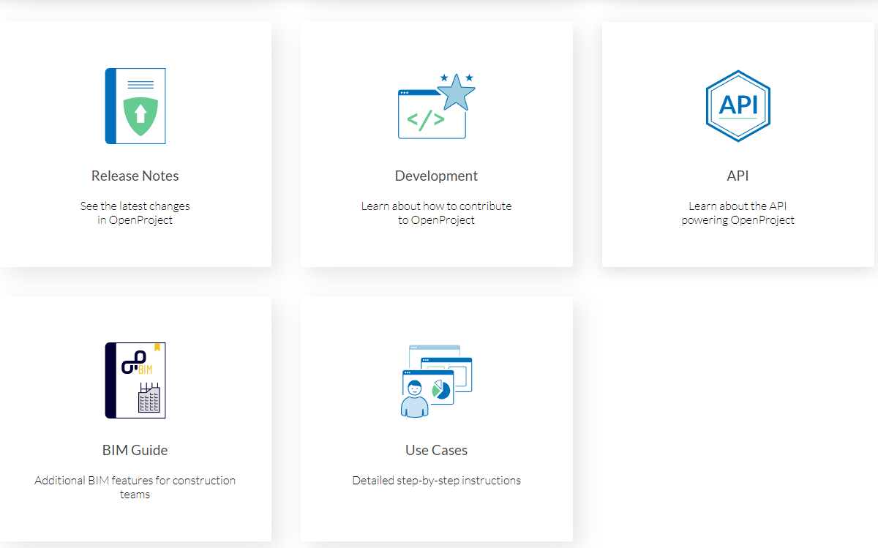

Support and Resource Options

Slide 17

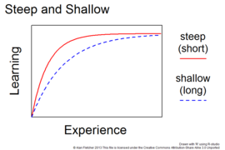

Constraints

